Slide 1





Next-Level
Data Engineering
ETL
Integrated with
Intelligent AI Agents

Slide 2
WHAT DOES A DATA ENGINEER DO, EXACTLY?
Anant
Computer Engineering 04 Prince of Songkla University
18 June 25
Build data pipelines to collect data and move it to storage
Prepare the data as part of an ETL or ELT process
Stitch the data together with scripting languages
Work with the DBA to construct data stores
Ensure the data is ready for use
Use frameworks and microservices to serve data
Database Administrator (DBA) A DBA is a professional responsible for the management, maintenance, security, and performance of databases
Tips

Slide 3
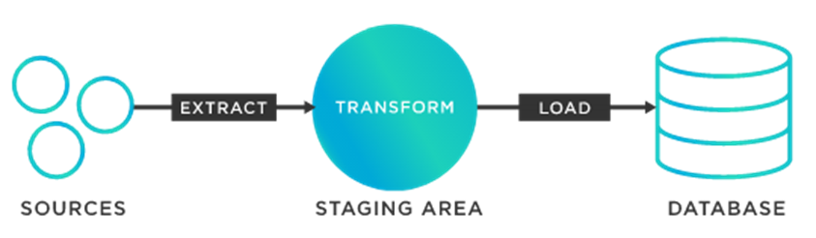
WHAT IS ETL ?
Anant
Computer Engineering 04 Prince of Songkla University
18 June 25
Outline
ETL is a process to extract data from a starting data source, transform the data in some fashion, then load it into another data store.

Slide 4
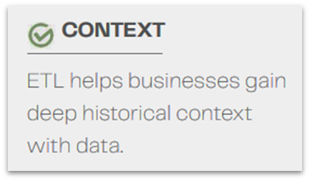
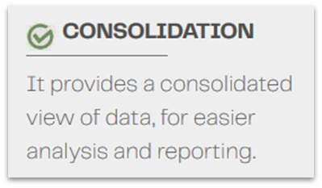
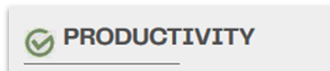
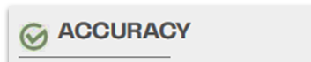
WHY IS ETL IMPORTANT?
Anant
Computer Engineering 04 Prince of Songkla University
18 June 25
Context
Consolidation
Productivity
Accuracy
ETL helps businesses gain deep historical context with data
It provides a consolidated view of data, for easier analysis and reporting
It improves productivity with repeatable processes that don’t require heavy hand-coding
It improves data accuracy and audit capabilities that most businesses require for compliance with regulations and standards

Slide 5
HOW DOES THE ETL PROCESS WORK?
Anant
Computer Engineering 04 Prince of Songkla University
18 June 25
TRADITIONAL ETL
MODERN ETL (ELT)
That data is generally extracted into a staging area, storage that sits between the data source and the data target.
In that staging area, the ETL tool transforms data, cleansing, joining, and otherwise optimizing it for analysis.
The cloud has the combination of speed, scalability, and practicality required for handling enormous amounts of structured and semi-structured data from literally dozens or hundreds of sources.

Slide 6
COMMON ETL CHALLENGES
Anant
Computer Engineering 04 Prince of Songkla University
18 June 25
SCALING
TRANSFORMING DATA ACCURATELY
HANDLING DIVERSE DATA SOURCES

Slide 7
WHAT ARE THE TYPES OF ETL TOOLS?
Anant
Computer Engineering 04 Prince of Songkla University
18 June 25
Batch
BATCH PROCESSING ETL TOOLS
Cloud
CLOUD-NATIVE ETL TOOLS
There are four different types of ETL tools available today.
Open source
OPEN SOURCE ETL TOOLS
Real-time
REAL-TIME ETL TOOLS

Slide 8
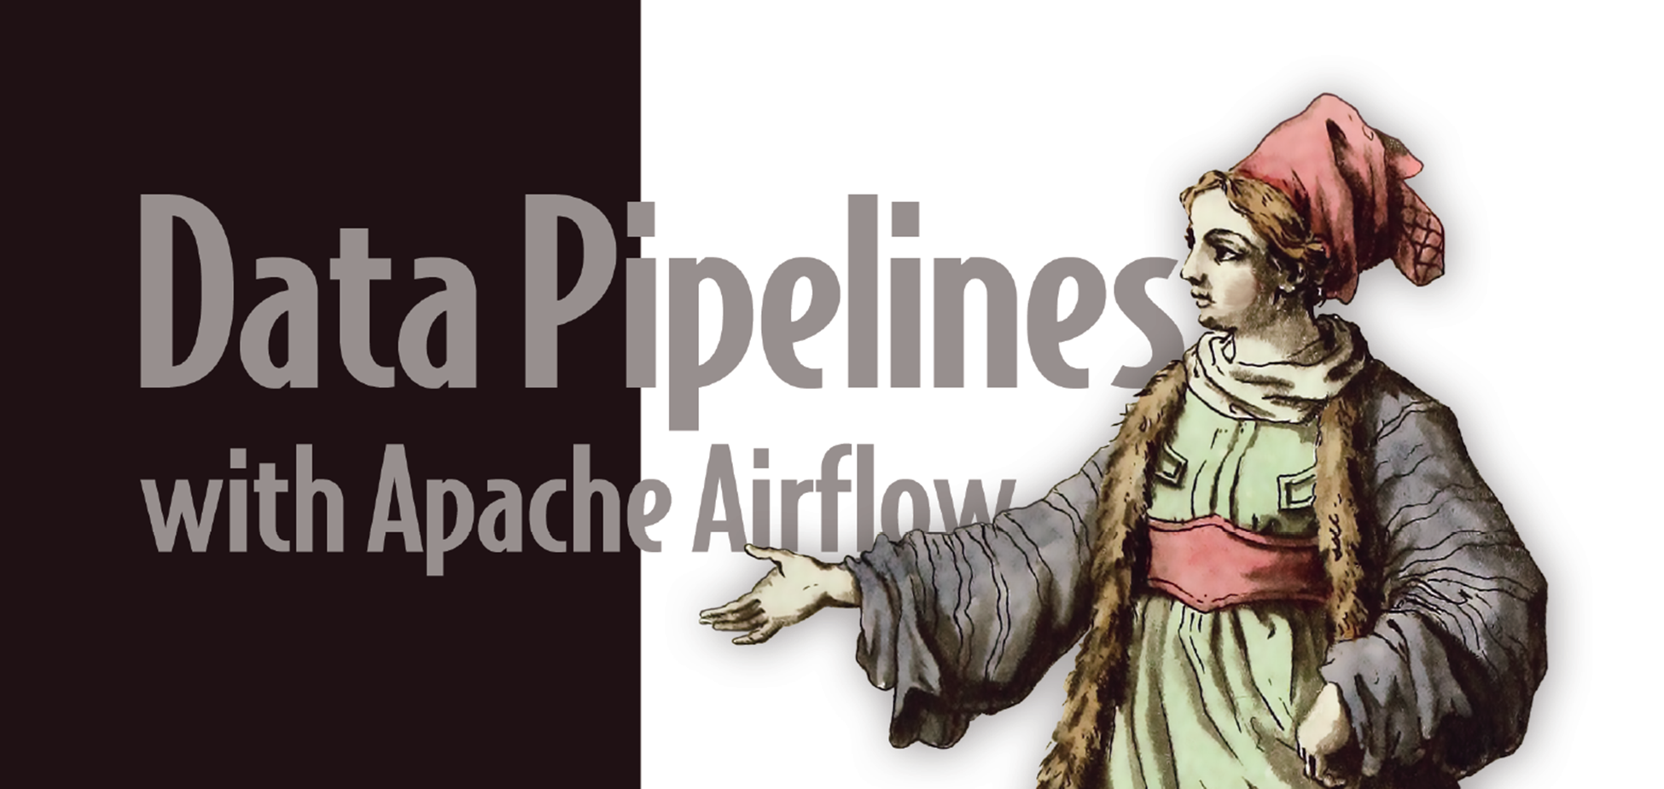
HOW IS ETL COMMONLY USED?
Anant
Computer Engineering 04 Prince of Songkla University
18 June 25
Outline
DATA WAREHOUSING
CLOUD MIGRATION
MACHINE LEARNING AND AI
MARKETING DATA INTEGRATION

Slide 9
WHAT IS THE FUTURE OF ETL?
Anant
Computer Engineering 04 Prince of Songkla University
18 June 25
Go
Past
Present
Future
Monday
EXPONENTIAL DATA GROWTH : The Internet of Things will continue to expand and play an increasing role in business and our lives.
May
2015
Monday
MORE MACHINE LEARNING AND ARTIFICIAL INTELLIGENCE : Preparing data for machine learning and artificial intelligence.
May
2025
Monday
THE DEMOCRATIZATION OF DATA : The more entire organizations can self-serve to gain actionable insights, the greater their competitive edge will be.
May
2035

Slide 10
HOW TO BUILD AN ETL STRATEGY
Anant
Computer Engineering 04 Prince of Songkla University
18 June 25
UTILIZE
MOVE
INVEST
UTILIZE : Utilize all of the data it collects, structured and semi-structured, operational, and transactional, to gain the maximum amount of insight for innovation and decision making.
MOVE : Move to a platform where it can effectively collect and analyze all of this data. Right now, a cloud data warehouse is the most practical solution from the perspective of speed, scale, and cost.
INVEST : Invest in an ETL tool that can help it extract data and transform it for cloud data analytics as quickly as possible to reduce time to insight.

Slide 11
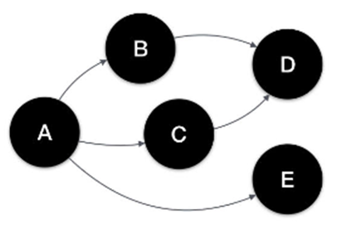
Introduction to Apache Airflow
Anant
Computer Engineering 04 Prince of Songkla University
18 June 25
Outline
Workflows are created using python scripts, which define how your tasks are executed. They are usually defined as Directed Acyclic Graphs(DAG).
Apache Airflow is an orchestration tool that helps you to programmatically create and handle task execution into a single workflow. It then handles monitoring its progress and takes care of scheduling future workflows depending on the schedule defined.

Slide 12



What is Apache Airflow ?
Anant
Computer Engineering 04 Prince of Songkla University
18 June 25
Authoring
Scheduling
Monitoring
Aireflow is an open source platform for programmatically authoring, scheduling, and monitoring workflows.
Workflows is Airflow are written as Directed Acyclic Graphs (DAGs) in Python
Users can specify when a workflow start, end after what interval it should run again
Airflow provides an interactive web interface to monitor your workflow

Slide 13
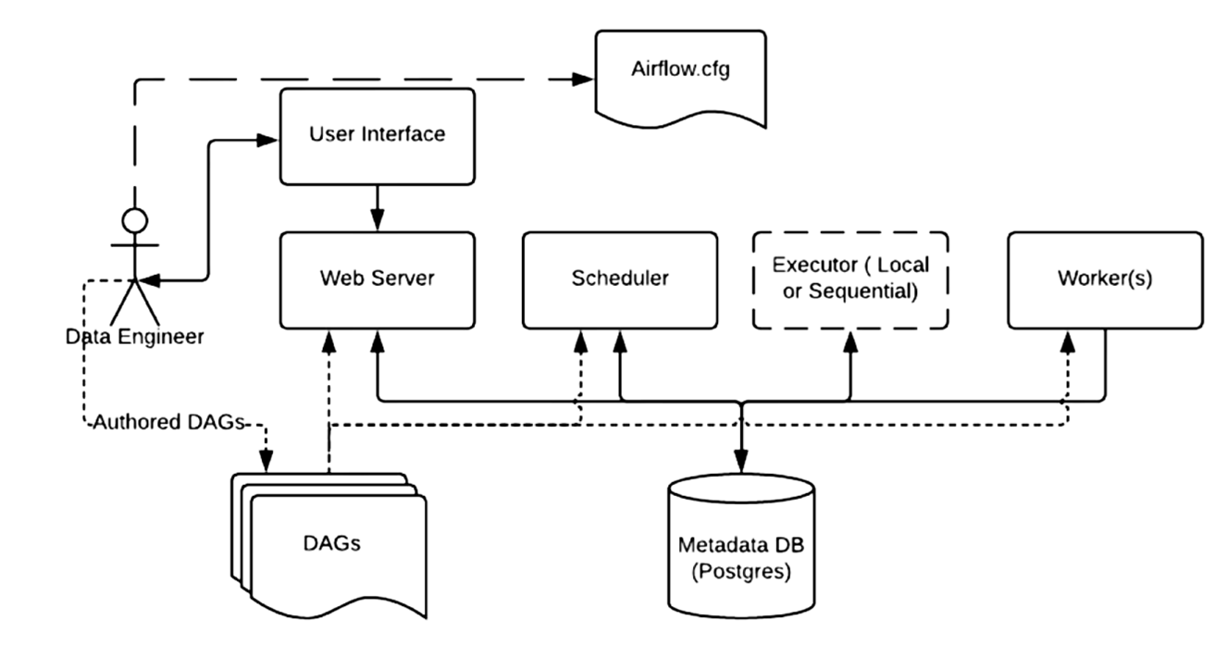
Architecture Overview
Anant
Computer Engineering 04 Prince of Songkla University
18 June 25

Slide 14
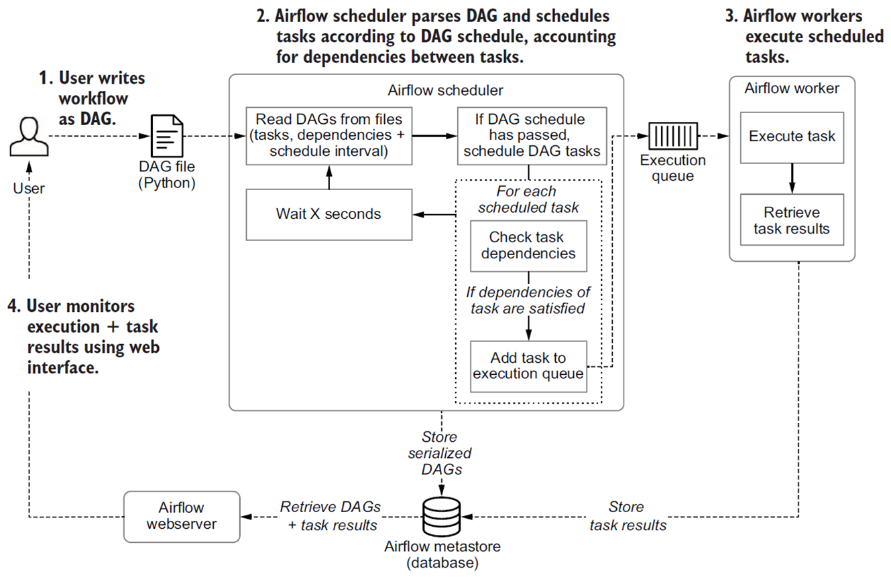
Process in developing and executing pipelines
Anant
Computer Engineering 04 Prince of Songkla University
18 June 25

Slide 15
Core concepts of Apache Airflow
Anant
Computer Engineering 04 Prince of Songkla University
18 June 25
●Core concepts - dags, tasks, operators, workflows
●Architecture - web server, scheduler, brokers, workers
●Advance concepts - Xcoms, pools, SLA
●Practice - Hands on experience by solving problems with airflow

Slide 16
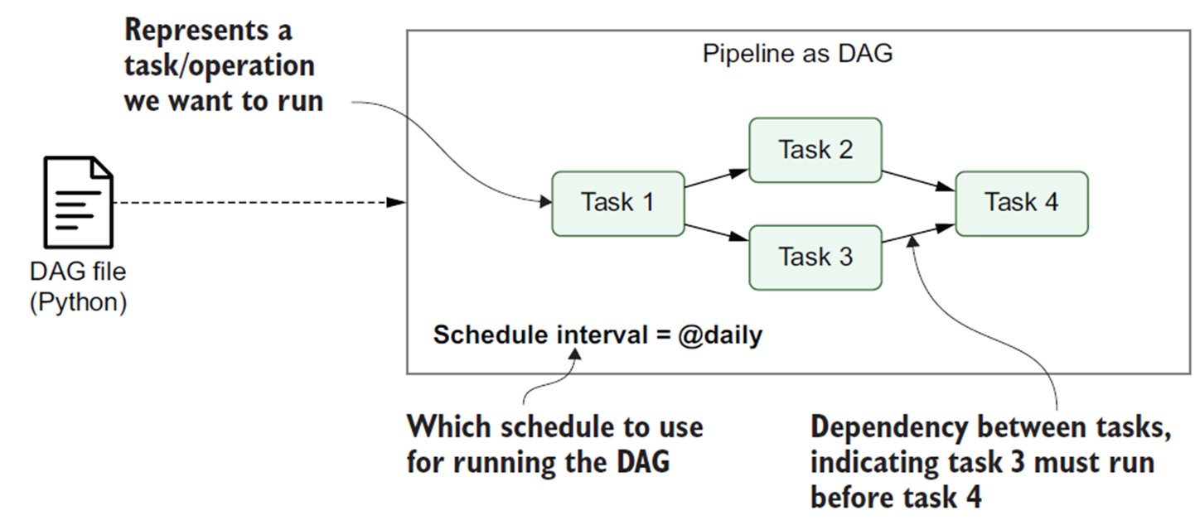
Airflow DAG
Anant
Computer Engineering 04 Prince of Songkla University
18 June 25

Slide 17
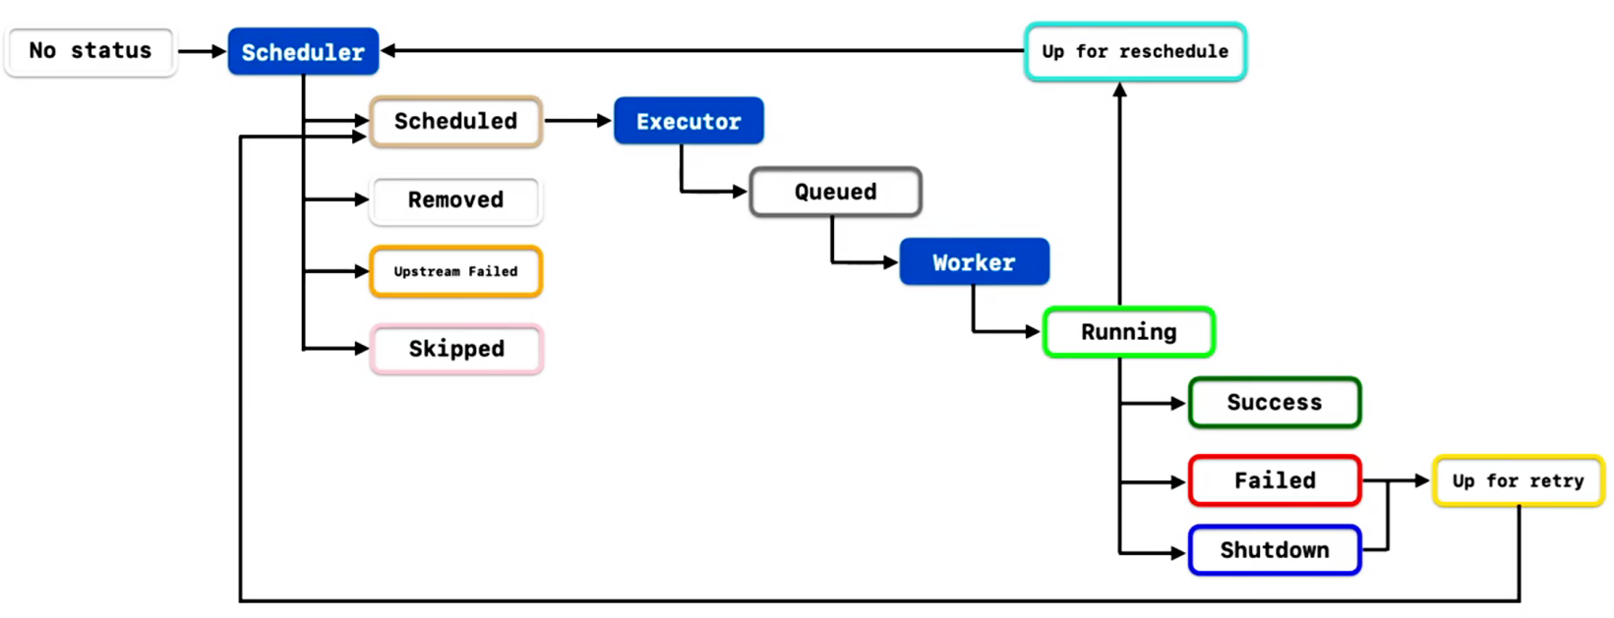
Airflow Task Lifecycle
Anant
Computer Engineering 04 Prince of Songkla University
18 June 25

Slide 18


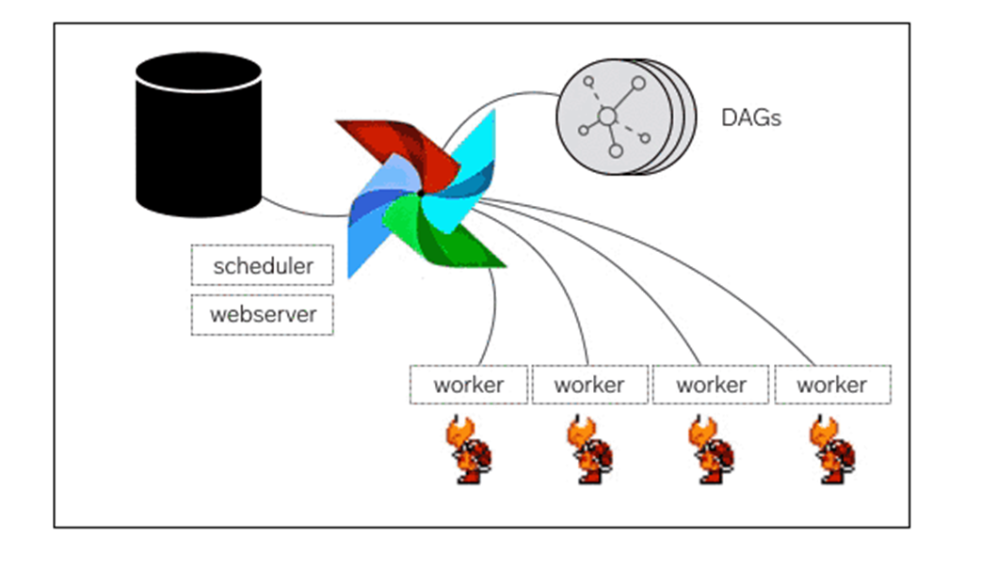


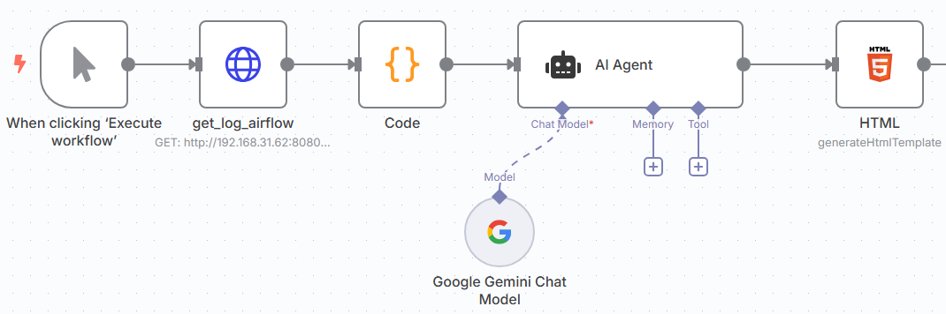
Check up !
Anant
Computer Engineering 04 Prince of Songkla University
18 June 25
VScode/Cursor
Docker
Airflow
n8n
LLM
AI Agents

Slide 19
Check up ! : Cursor
Anant
Computer Engineering 04 Prince of Songkla University
18 June 25
Cursor
Docker
Airflow
n8n
LLM
AI Agents

Slide 20
Check up ! : Docker
Anant
Computer Engineering 04 Prince of Songkla University
18 June 25
Cursor
Docker
Airflow
n8n
LLM
AI Agents

Slide 21
Check up ! : Airflow
Anant
Computer Engineering 04 Prince of Songkla University
18 June 25
Cursor
Docker
Airflow
n8n
LLM
AI Agents
ดาวโหลดไฟล์ docker-compose.yaml ตามลิงค์
บันทึกที่ Desktop\ETL\airflow
ไปที่ Docker Terminal
ไปยัง folder บน Desktop\ETL\airflow
พิมพ์คำสั่ง mkdir dags logs plugins
สั่ง docker-compose up airflow-init
รอจนเสร็จสิ้น สังเกตข้อความ exited with code 0
เริ่ม airflow สั่ง docker-compose up -d
หยุด airflow สั่ง docker-compose down
ถอนติดตั้ง docker-compose down –volumes –rmi all

Slide 22
Check up ! : Airflow
Anant
Computer Engineering 04 Prince of Songkla University
18 June 25
Cursor
Docker
Airflow
n8n
LLM
AI Agents
เปิดใช้งาน airflow
เปิด browser ไปยังลิงค์ localhost:8080
Login เข้าใช้ user/password : airflow
ดู ip ของเครื่องคำสั่ง ipconfig ที่ command prompt

Slide 23
Check up ! : n8n
Anant
Computer Engineering 04 Prince of Songkla University
18 June 25
Cursor
Docker
Airflow
n8n
LLM
AI Agents
ไปที่ Docker terminal
cd ไปที่ Desktop\ETL\
สั่ง mkdir n8n
เริ่มติดตั้ง n8n
สั่ง docker run -it --rm --name n8n -p 5678:5678 -v [n8n_path]:/home/node/.n8n docker.n8n.io/n8nio/n8n
รอดำเนินการจนแล้วเสร็จ
เข้าใช้งานที่ browser ลิงค์ localhost:5678
กำหนด login แนะนำให้ใช้ gmail
ดำเนินการจนสำเร็จ ยินดีด้วย :)
หากต้องการใช้งานผ่าน internet ได้ติดตั้ง ngrok

Slide 24
Check up ! : LLM&AI Agents
Anant
Computer Engineering 04 Prince of Songkla University
18 June 25
Cursor
Docker
Airflow
n8n
LLM
AI Agents
เข้าใช้ n8n
ขอ api_key สำหรับเปิดใช้ LLM
Gemini ไปที่ https://aistudio.google.com/
DeepSeek ที่ https://platform.deepseek.com/
ChatGPT ที่ https://platform.openai.com/
สร้าง AI Agent

Slide 25


Slide 26
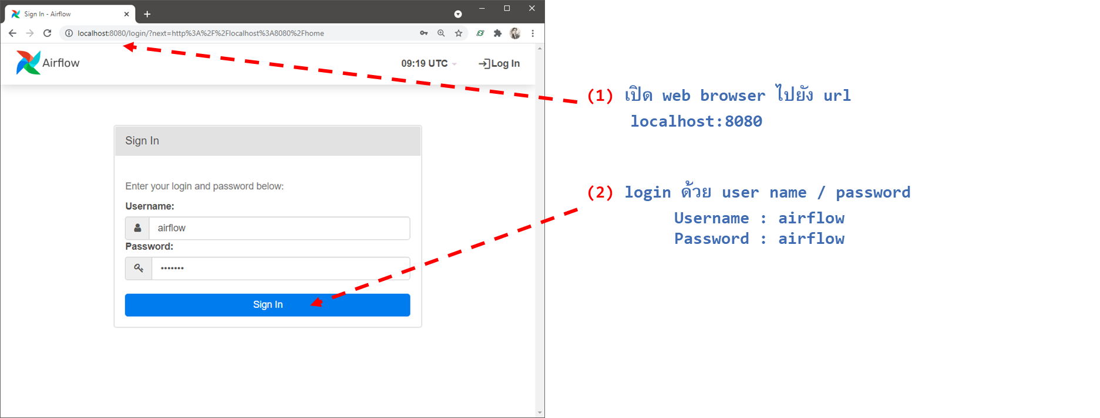
Login Airflow Web UI
Anant
Computer Engineering 04 Prince of Songkla University
18 June 25

Slide 27
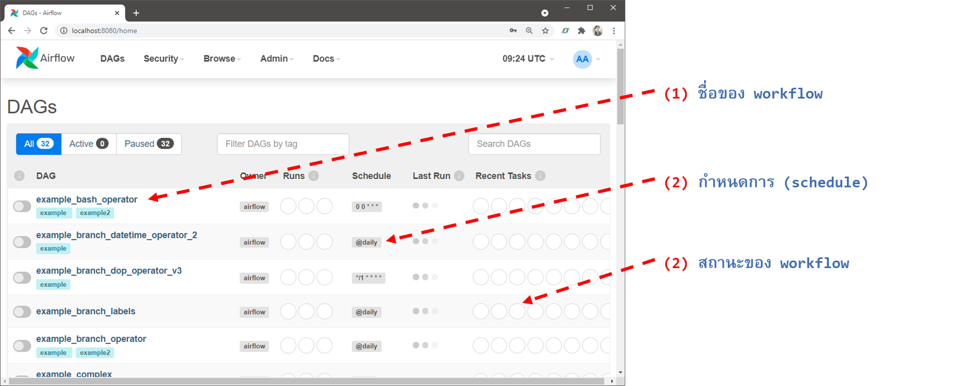
Airflow Web UI
Anant
Computer Engineering 04 Prince of Songkla University
18 June 25

Slide 28
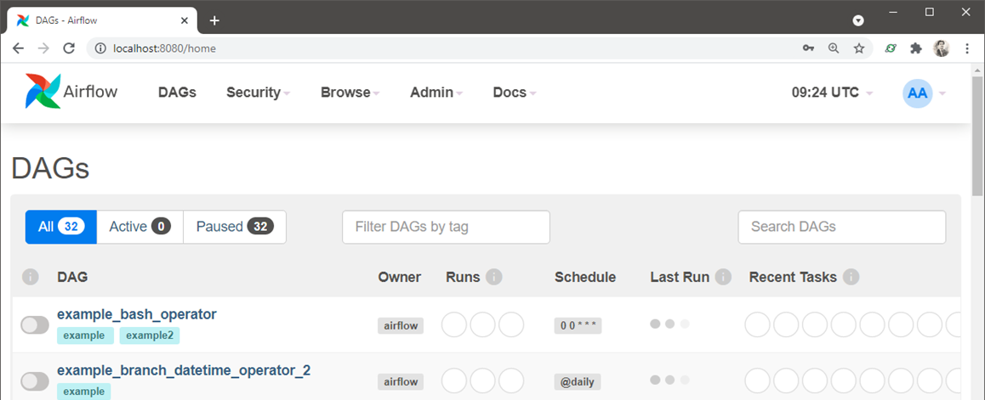
Check point #1
Anant
Computer Engineering 04 Prince of Songkla University
18 June 25
จับหน้าจอแสดงการเข้าใช้งาน Airflow Web UI ดังตัวอย่าง บันทึกภาพเก็บไว้ส่ง Exercise

Slide 29
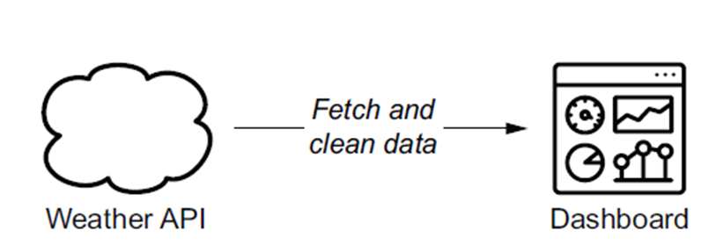
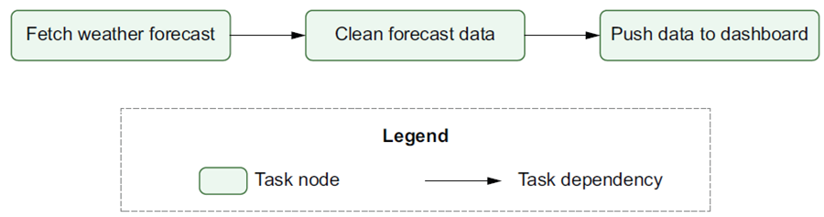
Introducing data pipelines
Anant
Computer Engineering 04 Prince of Songkla University
18 June 25
Fetch weather forecast data from a weather API.
Clean or otherwise transform the fetched data (e.g., converting temperatures from Fahrenheit to Celsius or vice versa), so that the data suits our purpose.
Push the transformed data to the weather dashboard.

Slide 30
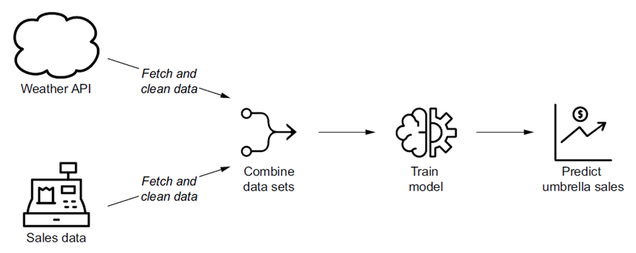
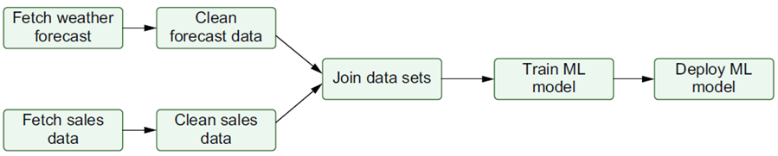
Pipeline graphs vs. sequential scripts
Anant
Computer Engineering 04 Prince of Songkla University
18 June 25
Prepare the sales data by doing the following:
– Fetching the sales data from the source system
– Cleaning/transforming the sales data to fit requirements
Prepare the weather data by doing the following:
– Fetching the weather forecast data from an API
– Cleaning/transforming the weather data to fit requirements
Combine the sales and weather data sets to create the combined data set that can be used as input for creating a predictive ML model.
Train the ML model using the combined data set.
Deploy the ML model so that it can be used by the business.

Slide 31
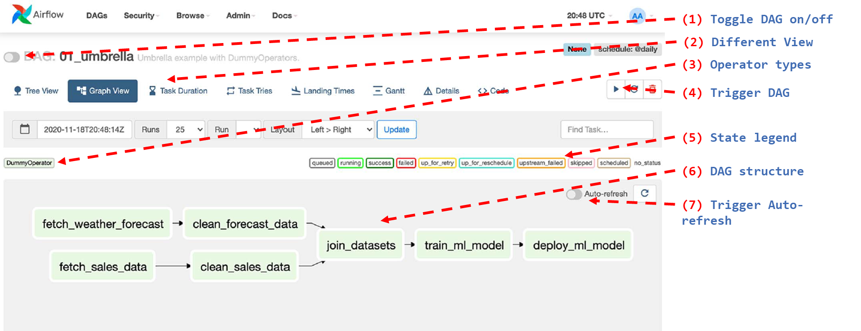
The graph view in Airflow’s web interface
Anant
Computer Engineering 04 Prince of Songkla University
18 June 25

Slide 32
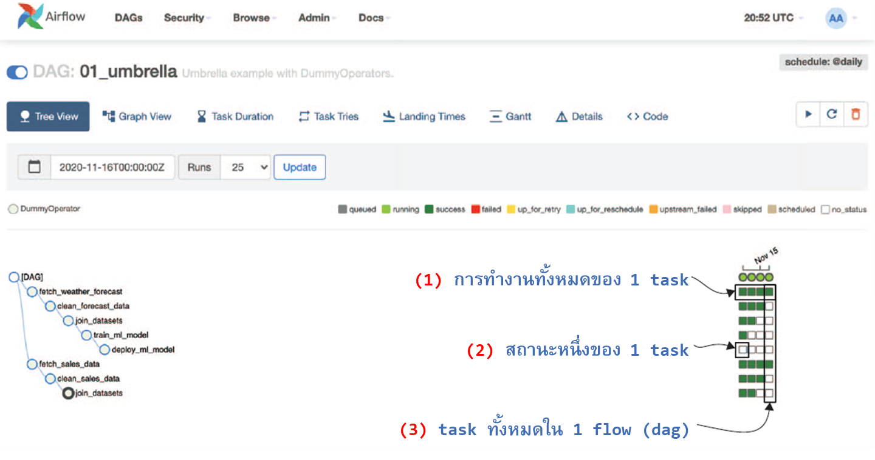
The graph view in Airflow’s web interface
Anant
Computer Engineering 04 Prince of Songkla University
18 June 25

Slide 33
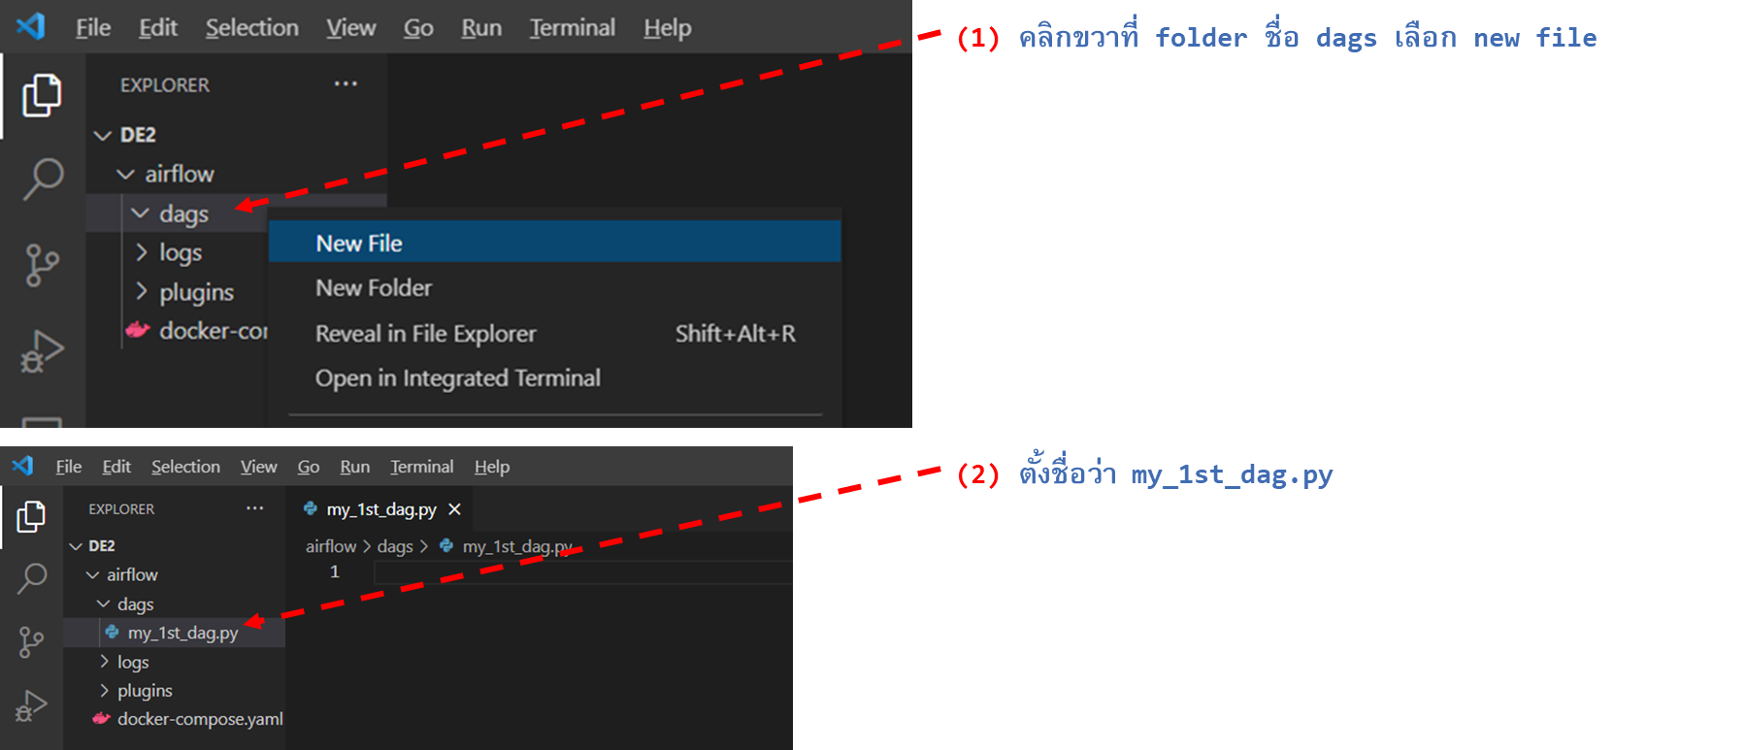
Let’s build your first DAG
Anant
Computer Engineering 04 Prince of Songkla University
18 June 25

Slide 34
Build Your First DAG
Anant
Computer Engineering 04 Prince of Songkla University
18 June 25
Importing Packages
from airflow import DAG
from airflow.operators.dummy_operator import DummyOperator
from airflow.utils import timezone
Setting Up default_args
default_args = {
'owner': 'airflow',
}

Slide 35
Build Your First DAG
Anant
Computer Engineering 04 Prince of Songkla University
18 June 25
Defining DAG, Tasks, and Operators
with DAG(
'my_1st_dag',
schedule_interval='*/5 * * * *',
default_args=default_args,
start_date=timezone.datetime(2020, 7, 10),
tags = ['ETL','Hello World'],
catchup=False,
) as dag :
t1 = DummyOperator(
task_id='my_1st_dummy_task',
dag=dag,)
t2 = DummyOperator(
task_id='my_2nd_dummy_task',
dag=dag,)
t1 >> t2

Slide 36
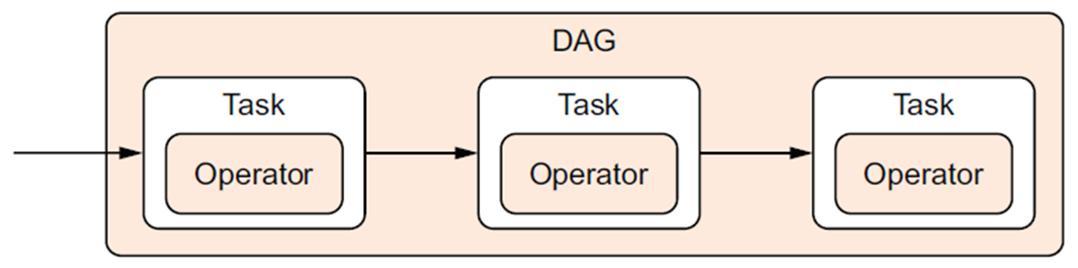
Tasks vs. operators
Anant
Computer Engineering 04 Prince of Songkla University
18 June 25
DAGs and operators are used by Airflow users. Tasks are
internal components to manage operator state and display state
changes (e.g., started/finished) to the user.

Slide 37
Basic operators
Anant
Computer Engineering 04 Prince of Songkla University
18 June 25
A workflow is made up of tasks and each task is an operator. Now, what is an operator? An operator a python class that does some work for you. These classes are provided by airflow itself. Some basic operators are
BashOperator - used to run bash commands.
PythonOperator - used to run a python function you define.
BranchOperator - used to create a branch in the workflow.
DummyOperator - used to represent a dummy task.

Slide 38
BashOperator
Anant
Computer Engineering 04 Prince of Songkla University
18 June 25
from airflow.operators.bash_operator import BashOperator
echo_hello = BashOperator(
task_id='echo_hello',
bash_command='echo hello',
dag=dag
)

Slide 39
PythonOperator
Anant
Computer Engineering 04 Prince of Songkla University
18 June 25
from airflow.operators.python_operator import PythonOperator
def hello():
return 'Hello, Python'
say_hello = PythonOperator(
task_id='say_hello',
python_callable=hello,
dag=dag
)

Slide 40
Logging
Anant
Computer Engineering 04 Prince of Songkla University
18 June 25
import logging
def print_log_messages():
logging.debug('This is a debug message')
logging.info('This is an info message')
logging.warning('This is a warning message')
logging.error('This is an error message')
logging.critical('This is a critical message')
return 'Whatever is returned also gets printed in the logs'
print_log = PythonOperator(
task_id='print_log_messages',
python_callable=print_log_messages,
dag=dag,
)

Slide 41
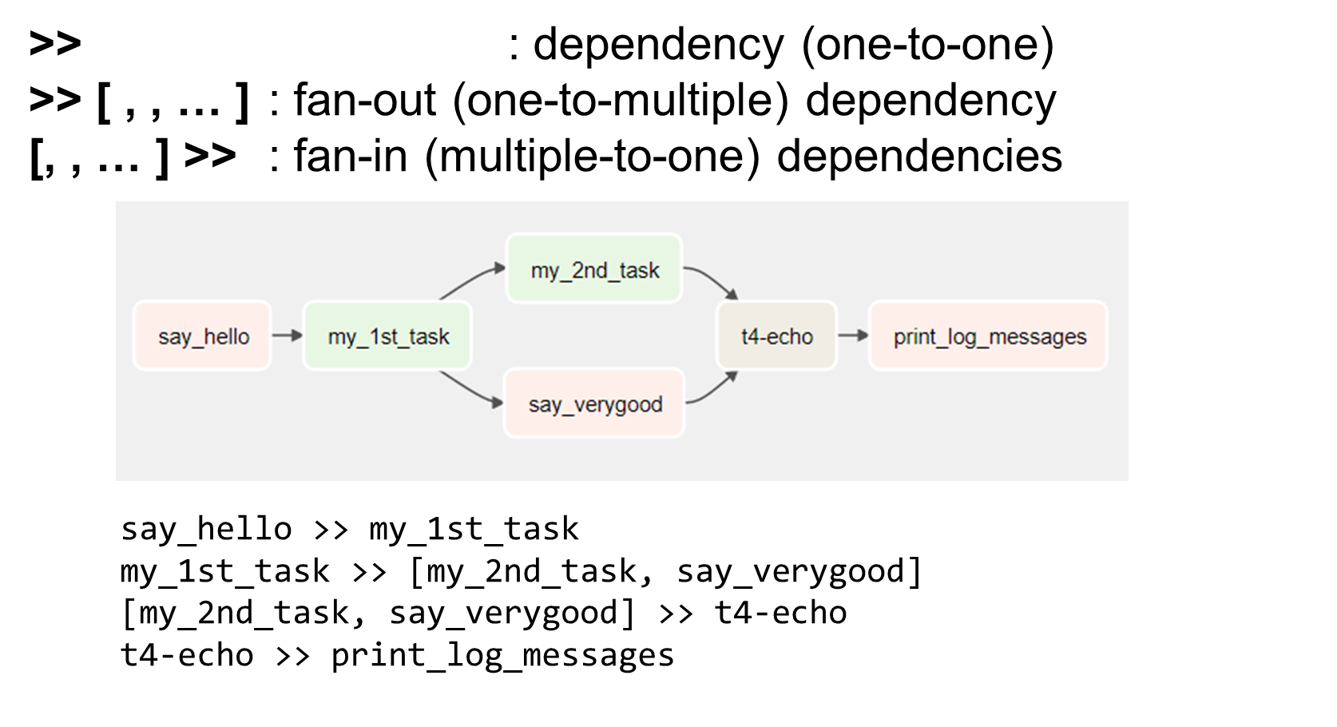
Defining dependencies between tasks
Anant
Computer Engineering 04 Prince of Songkla University
18 June 25

Slide 42
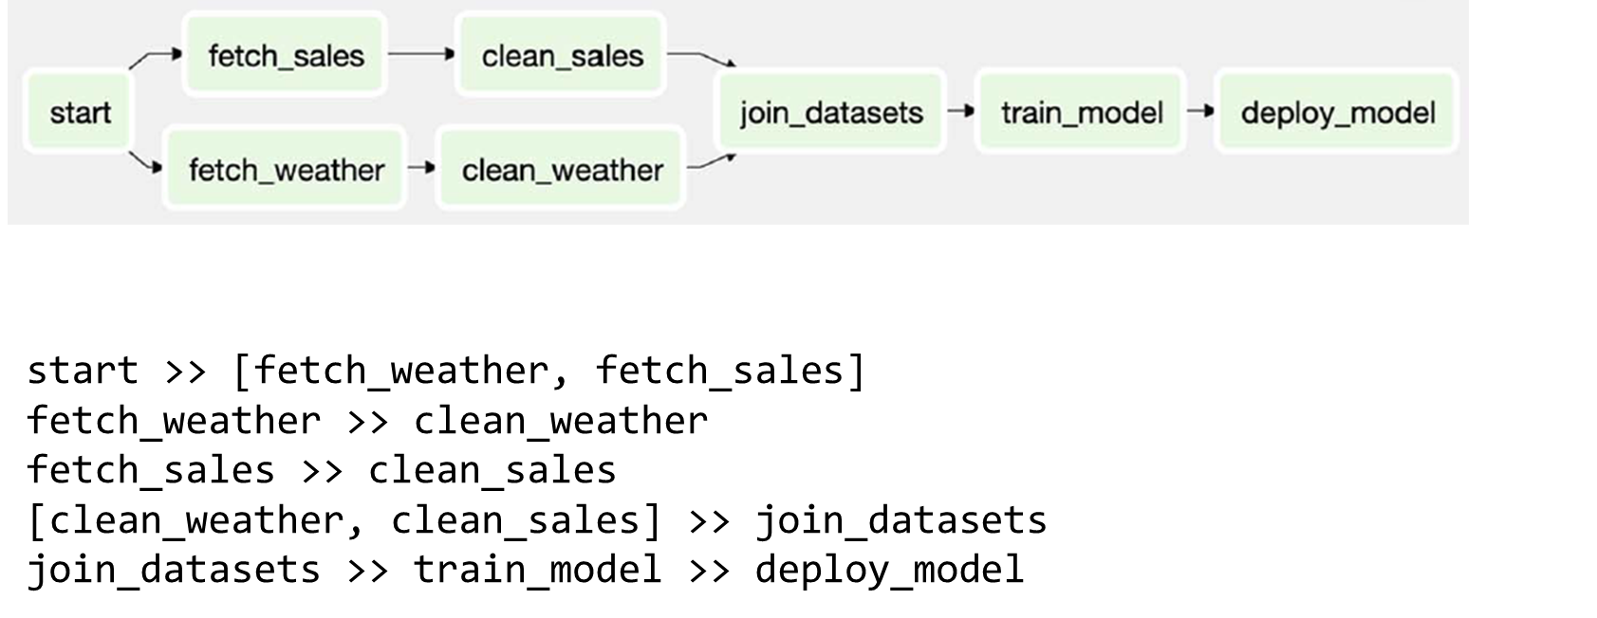
Branching within the DAG (more)
Anant
Computer Engineering 04 Prince of Songkla University
18 June 25

Slide 43
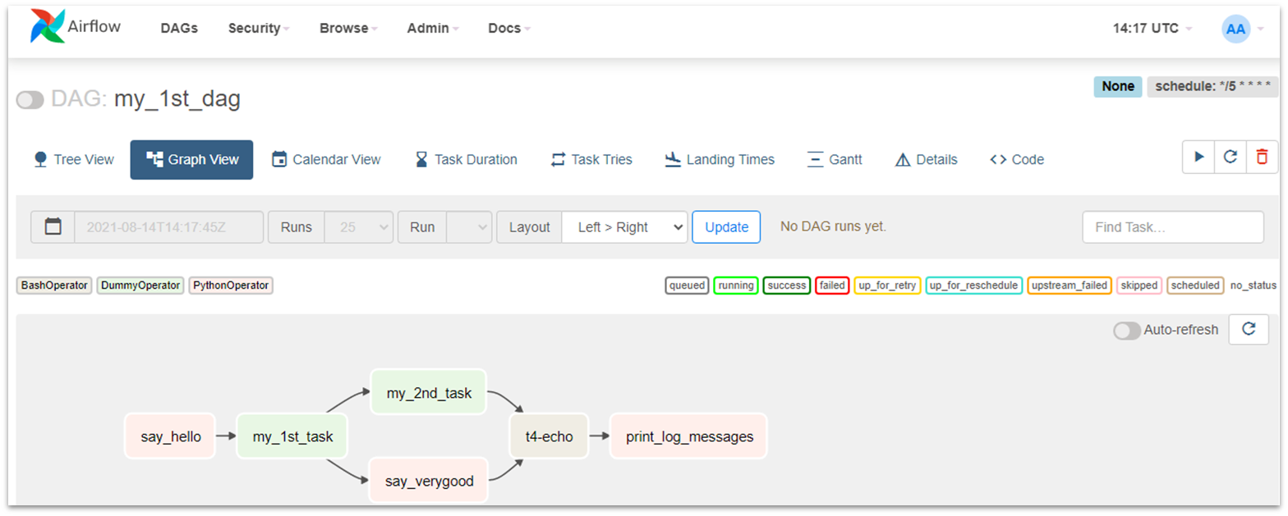
Check point #2
Anant
Computer Engineering 04 Prince of Songkla University
18 June 25
ปรับปรุงไฟล์ my_1st_dag.py ที่ได้สร้างขึ้น ทดลองใช้งาน Operators ตัวอื่น ๆ แล้ว ดู Graph View ใน Airflow UI จับหน้าจอ บันทึกภาพเก็บไว้ส่ง Exercise

Slide 44
Anatomy of an Airflow.
Anant
Computer Engineering 04 Prince of Songkla University
18 June 25
As an example, Let’s create a workflow that does the following
Check if the URL is available
Fetches some data from an URL
Extract certain fields from it.
Print the extracted fields using the bash echo command.

Slide 45
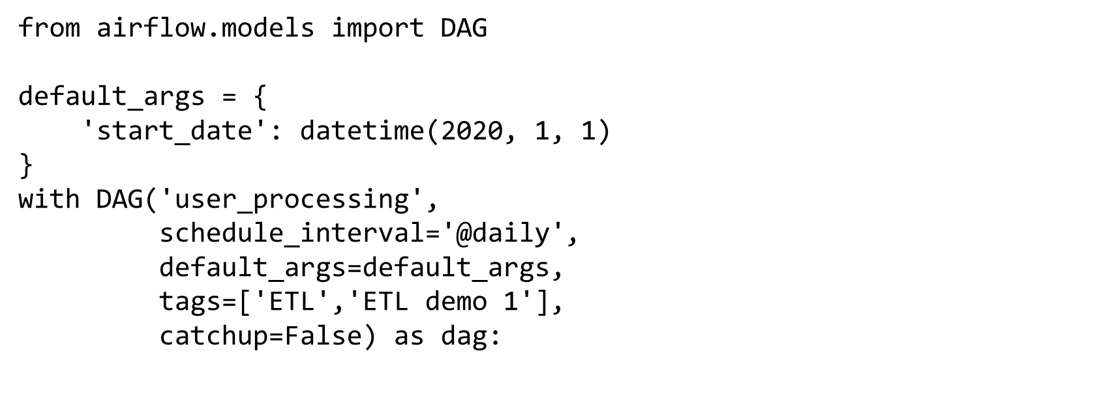
Creating your DAG Definition
Anant
Computer Engineering 04 Prince of Songkla University
18 June 25
First, we will create a skeleton of the workflow, i.e, in this case, is the DAG definition.

Slide 46
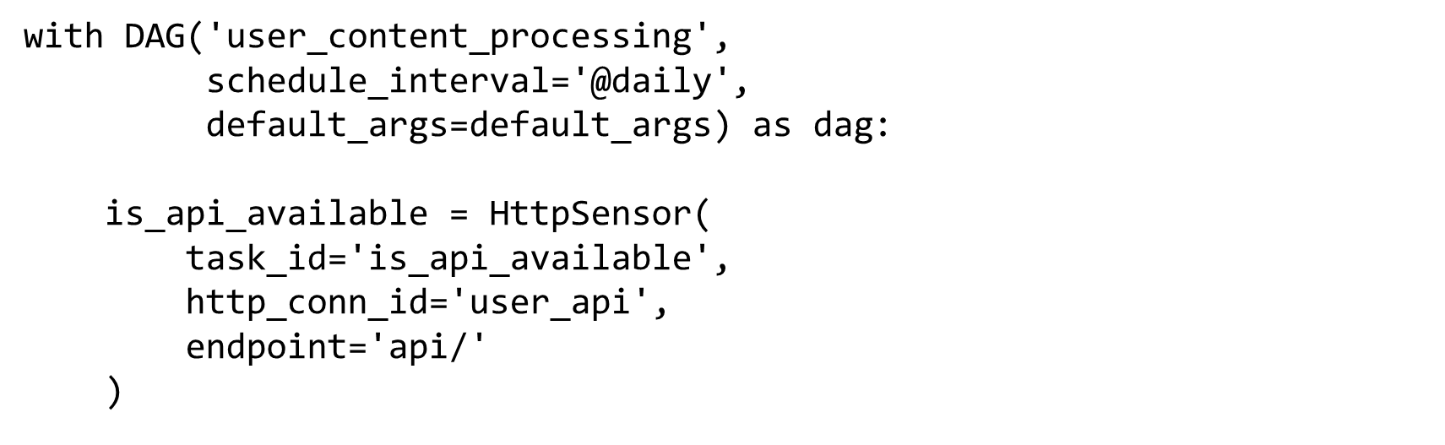
Creating our first task
Anant
Computer Engineering 04 Prince of Songkla University
18 June 25
Now, to check if our URL is reachable, we are going to use a sensor operator. In this case, it’s an HttpSensor operator.

Slide 47
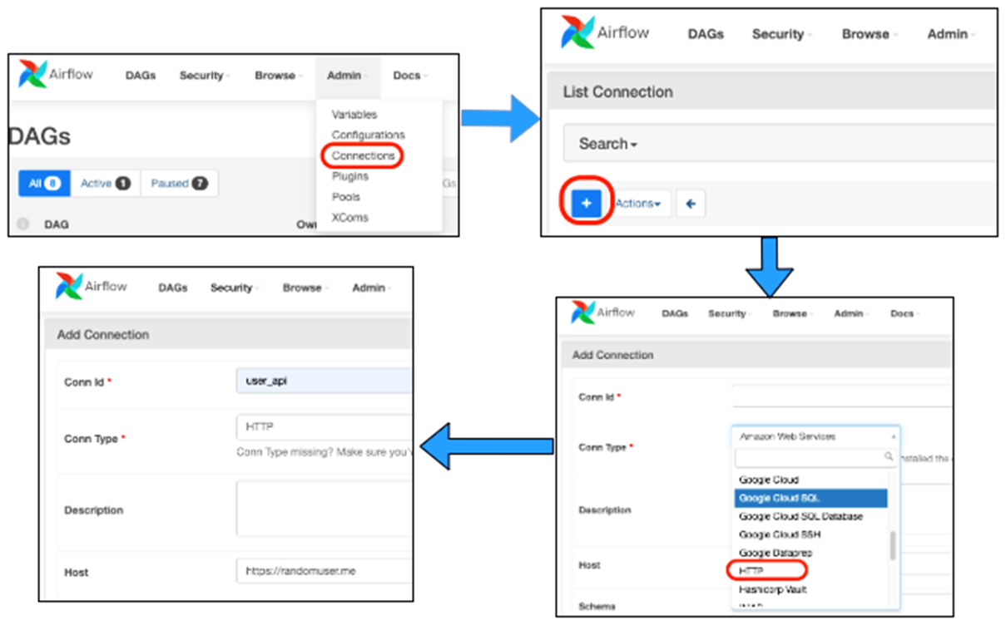
Creating Http Sensor
Anant
Computer Engineering 04 Prince of Songkla University
18 June 25
URL https://randomuser.me
In our case, we would be using the HTTP connection option.
Here we would provide the URL we want to trigger and setting the connection id to user_api which will return a JSON response of some random user information.

Slide 48
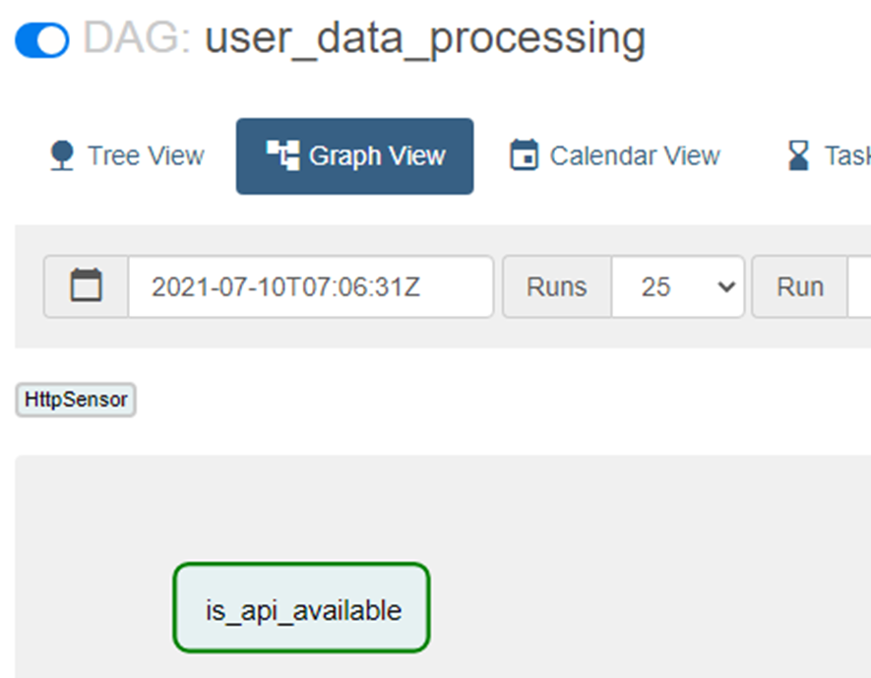
Finally, with this configured
Anant
Computer Engineering 04 Prince of Songkla University
18 June 25
The task is ready to make a call to the URL with the endpoint provided.

Slide 49
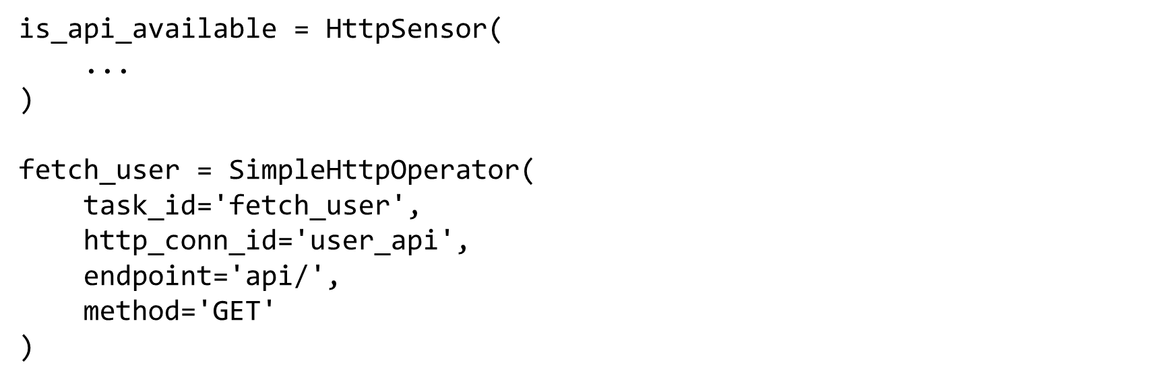
Execute next task
Anant
Computer Engineering 04 Prince of Songkla University
18 June 25
Now, once the first task execution succeeds, we are going to make use of an HttpOperator called SimpleHttpOperator.

Slide 50
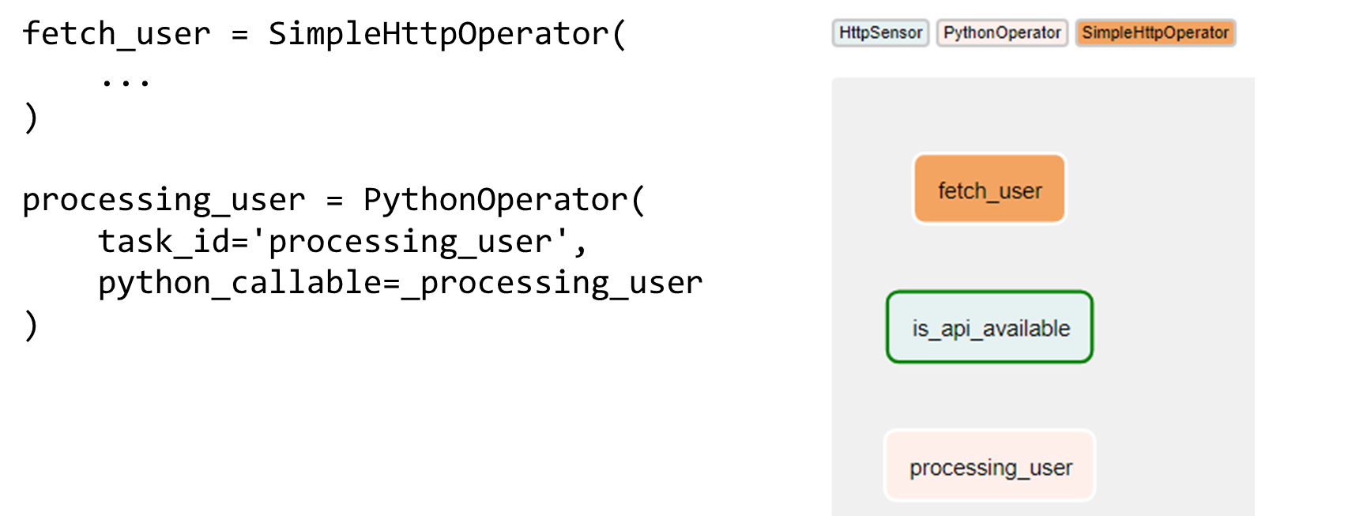
Xcoms
Anant
Computer Engineering 04 Prince of Songkla University
18 June 25
Xcoms is a way you can share data between your tasks. It basically stores key-value pairs of the information you want to store that can be accessed by other tasks in a DAG.

Slide 51
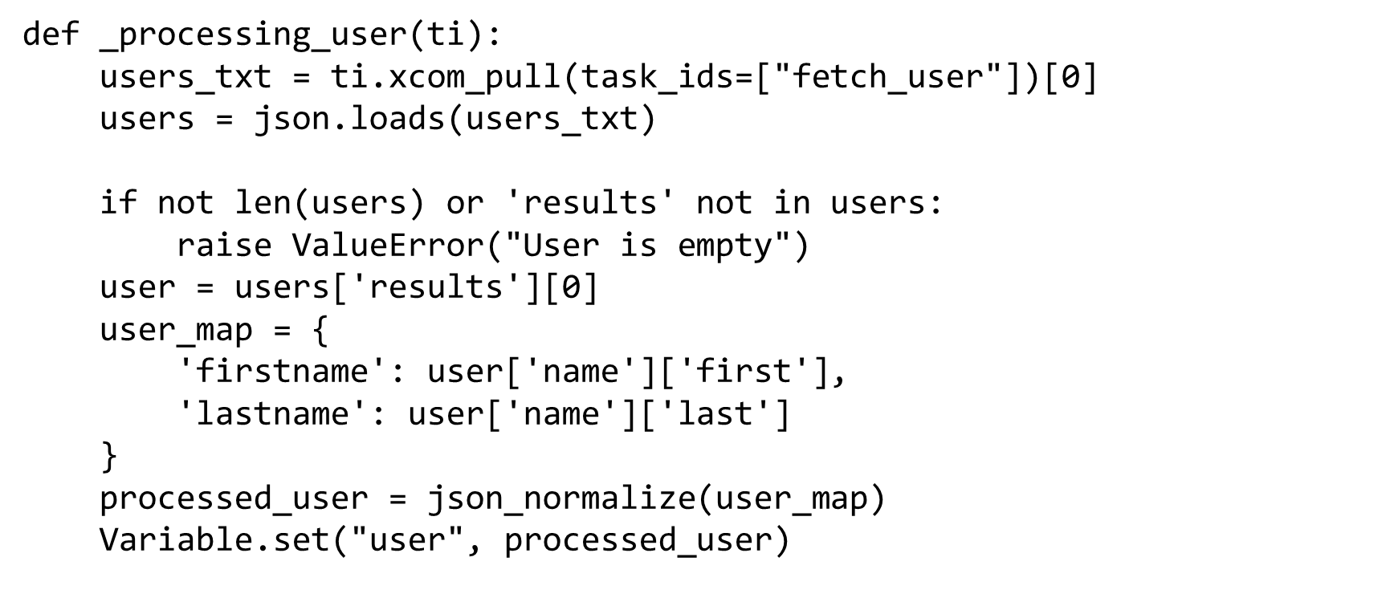
Let’s look at the function
Anant
Computer Engineering 04 Prince of Songkla University
18 June 25

Slide 52
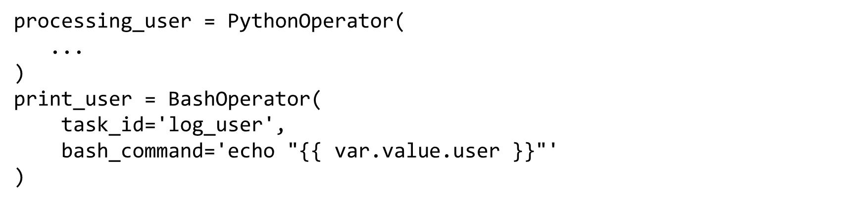
Variables
Anant
Computer Engineering 04 Prince of Songkla University
18 June 25
Variables are a way to store and extract some values that you would like to use across any DAG
Now that we have stored the values inside Variables, Let print them to the logs using the echo command. To do this we are going to use the BashOperator

Slide 53
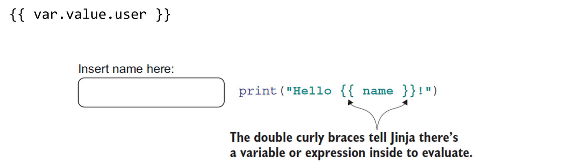
Templating
Anant
Computer Engineering 04 Prince of Songkla University
18 June 25
Airflow uses Jinja Templating. As you have seen in the code above, Curly braces which allow to materialize some values. In this case, the user key from Variables (using var ).

Slide 54
Ordering Your Tasks
Anant
Computer Engineering 04 Prince of Songkla University
18 June 25
Airflow uses Jinja Templating. As you have seen in the code above, Curly braces which allow to materialize some values. In this case, the user key from Variables (using var ).

Slide 55
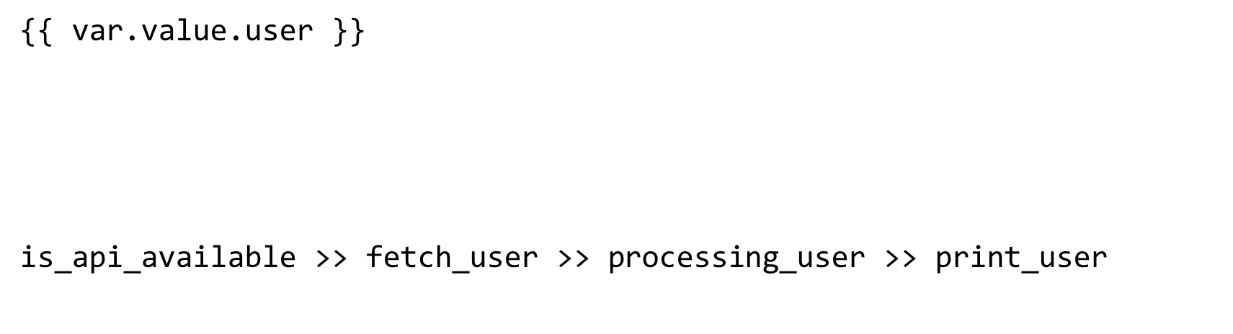
Ordering Your Tasks
Anant
Computer Engineering 04 Prince of Songkla University
18 June 25
Now, With all of this, we have created all the tasks instances.
This means Task 1 will run before Task 2. In our case, we will order this as

Slide 56
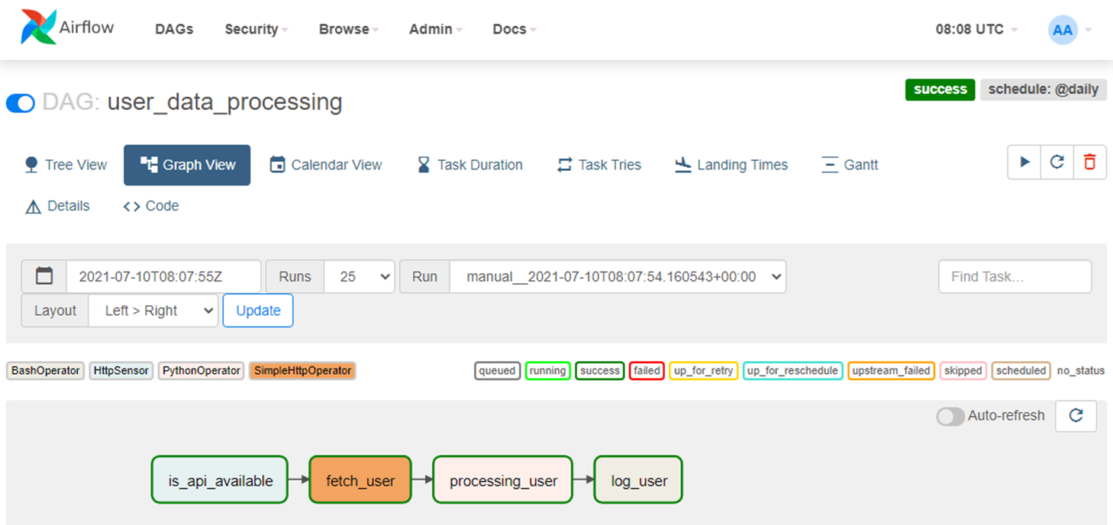
Check point #3
Anant
Computer Engineering 04 Prince of Songkla University
18 June 25
We just created a simple Airflow DAG workflow from scratch covering some of the important concepts of Airflow.
Now, enable the DAG and hit run. It will start executing.

Slide 57
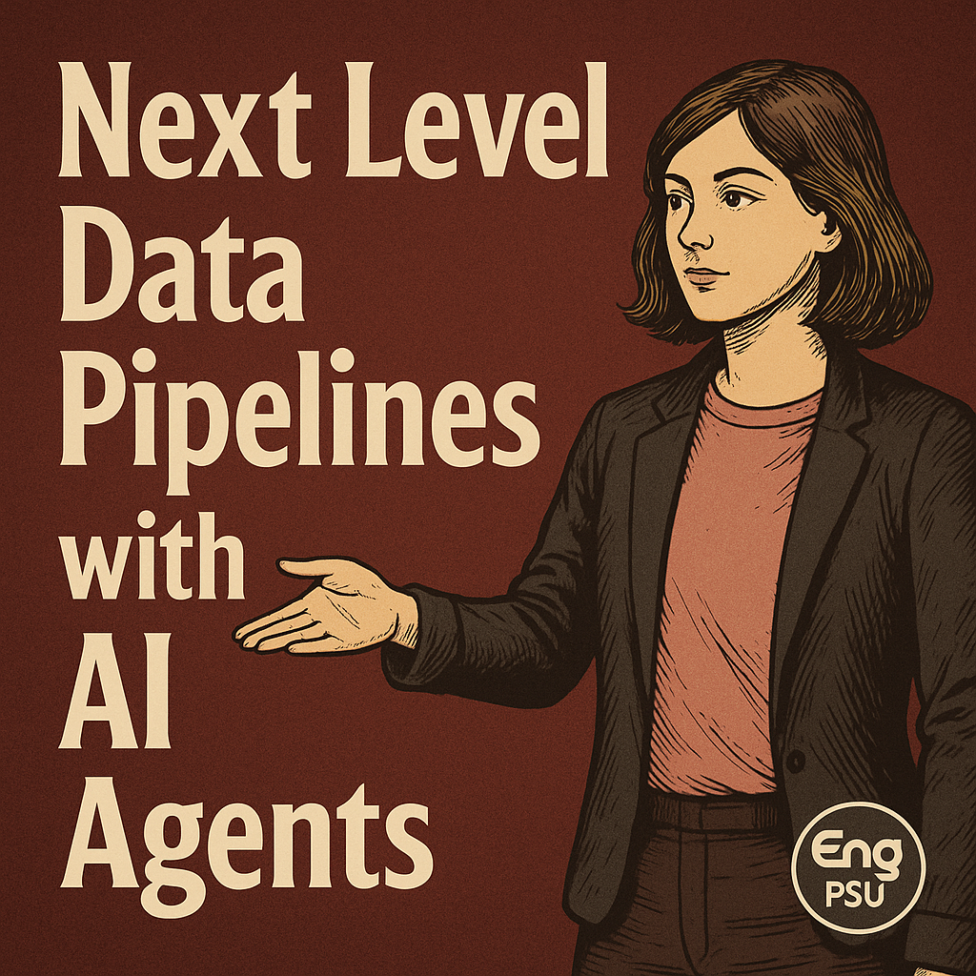
Next : AI Agents
Anant
Computer Engineering 04 Prince of Songkla University
18 June 25
What is an AI agentic workflow?
An AI agentic workflow is a mix of AI agents with traditional workflow automation. Unlike standard workflows that follow predefined steps, AI agentic workflows employ intelligent agents to make decisions, adapt to new situations, and autonomously achieve goals.

Slide 58
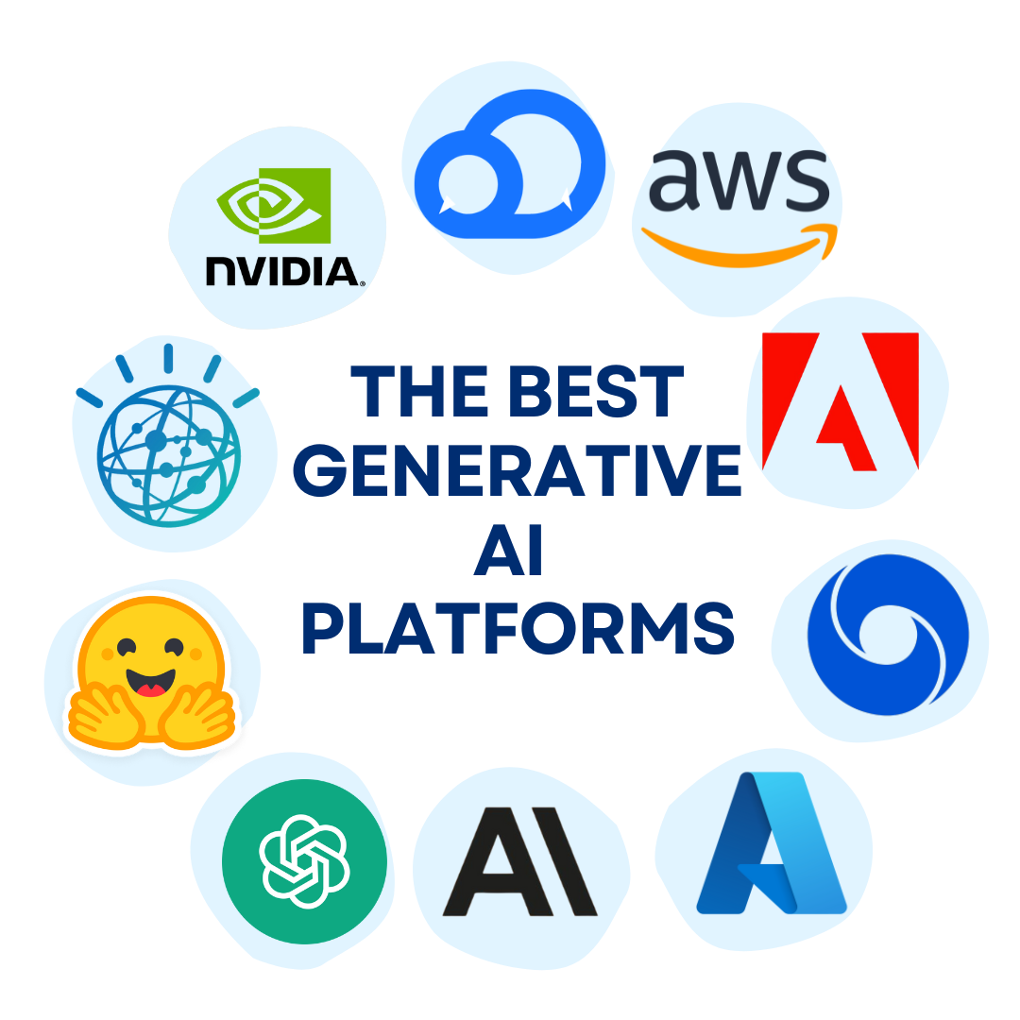
Key characteristics of AI agentic workflow
Anant
Computer Engineering 04 Prince of Songkla University
18 June 25
AI agentic workflows leverage large language models (LLMs) as their "brain power", allowing them to understand complex instructions, reason about tasks, and generate appropriate responses or actions.

Slide 59
Key characteristics of AI agentic workflow
Anant
Computer Engineering 04 Prince of Songkla University
18 June 25
Autonomy: Agents can operate independently, making decisions without constant human input.
Adaptability: They adjust their actions in response to changes in the environment or new information.
Goal-oriented: Agents work toward specific objectives rather than simply a set of rules.
Learning capability: Many AI agents can improve their performance over time.
Scalability: as agents learn, they can solve increasingly complex tasks without major reprogramming.

Slide 60
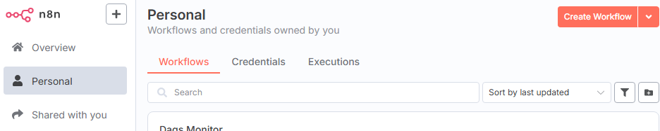
Let’s build your first AI Agent
Anant
Computer Engineering 04 Prince of Songkla University
18 June 25

Slide 61
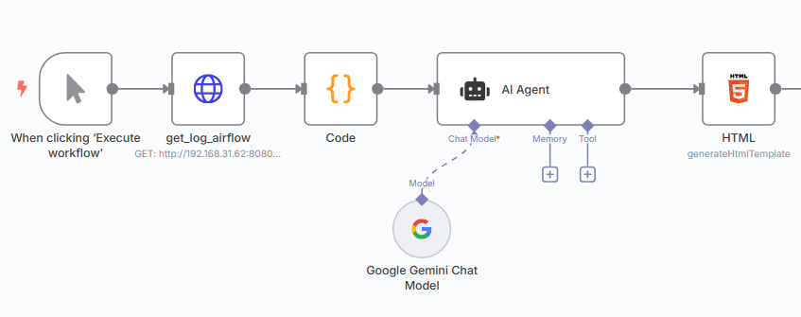
Let’s build your first AI Agent
Anant
Computer Engineering 04 Prince of Songkla University
18 June 25

Slide 62
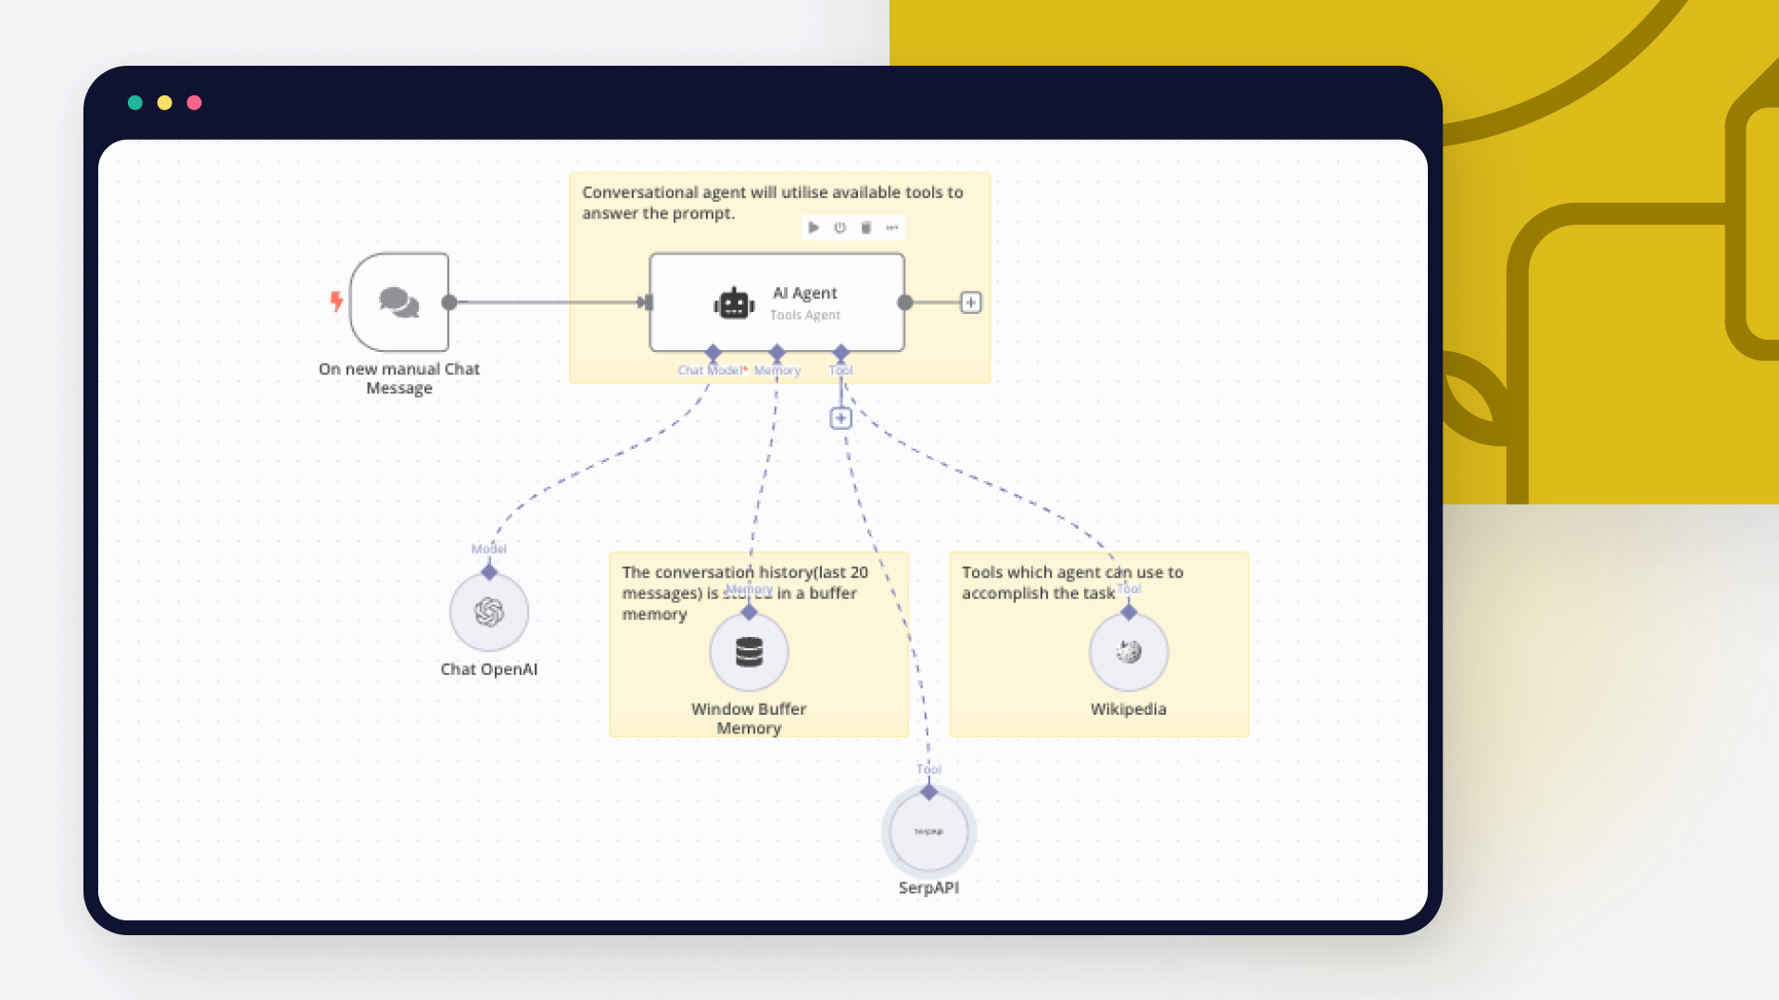
Your Practical Guide to LLM Agents in 2025
Anant
Computer Engineering 04 Prince of Songkla University
18 June 25

Slide 63
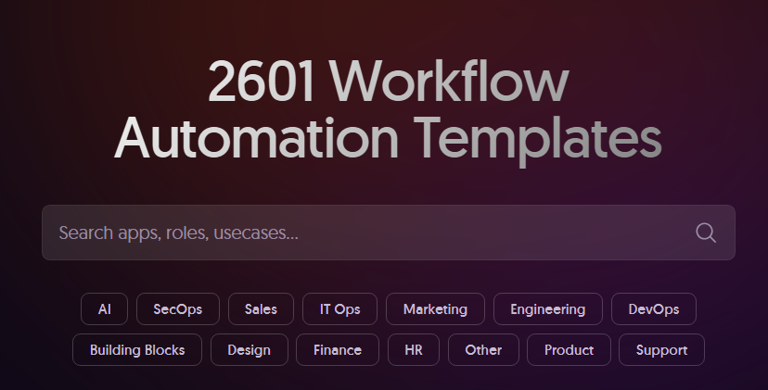
Your turn , Check point #4
Anant
Computer Engineering 04 Prince of Songkla University
18 June 25

Slide 64


